Slide 1
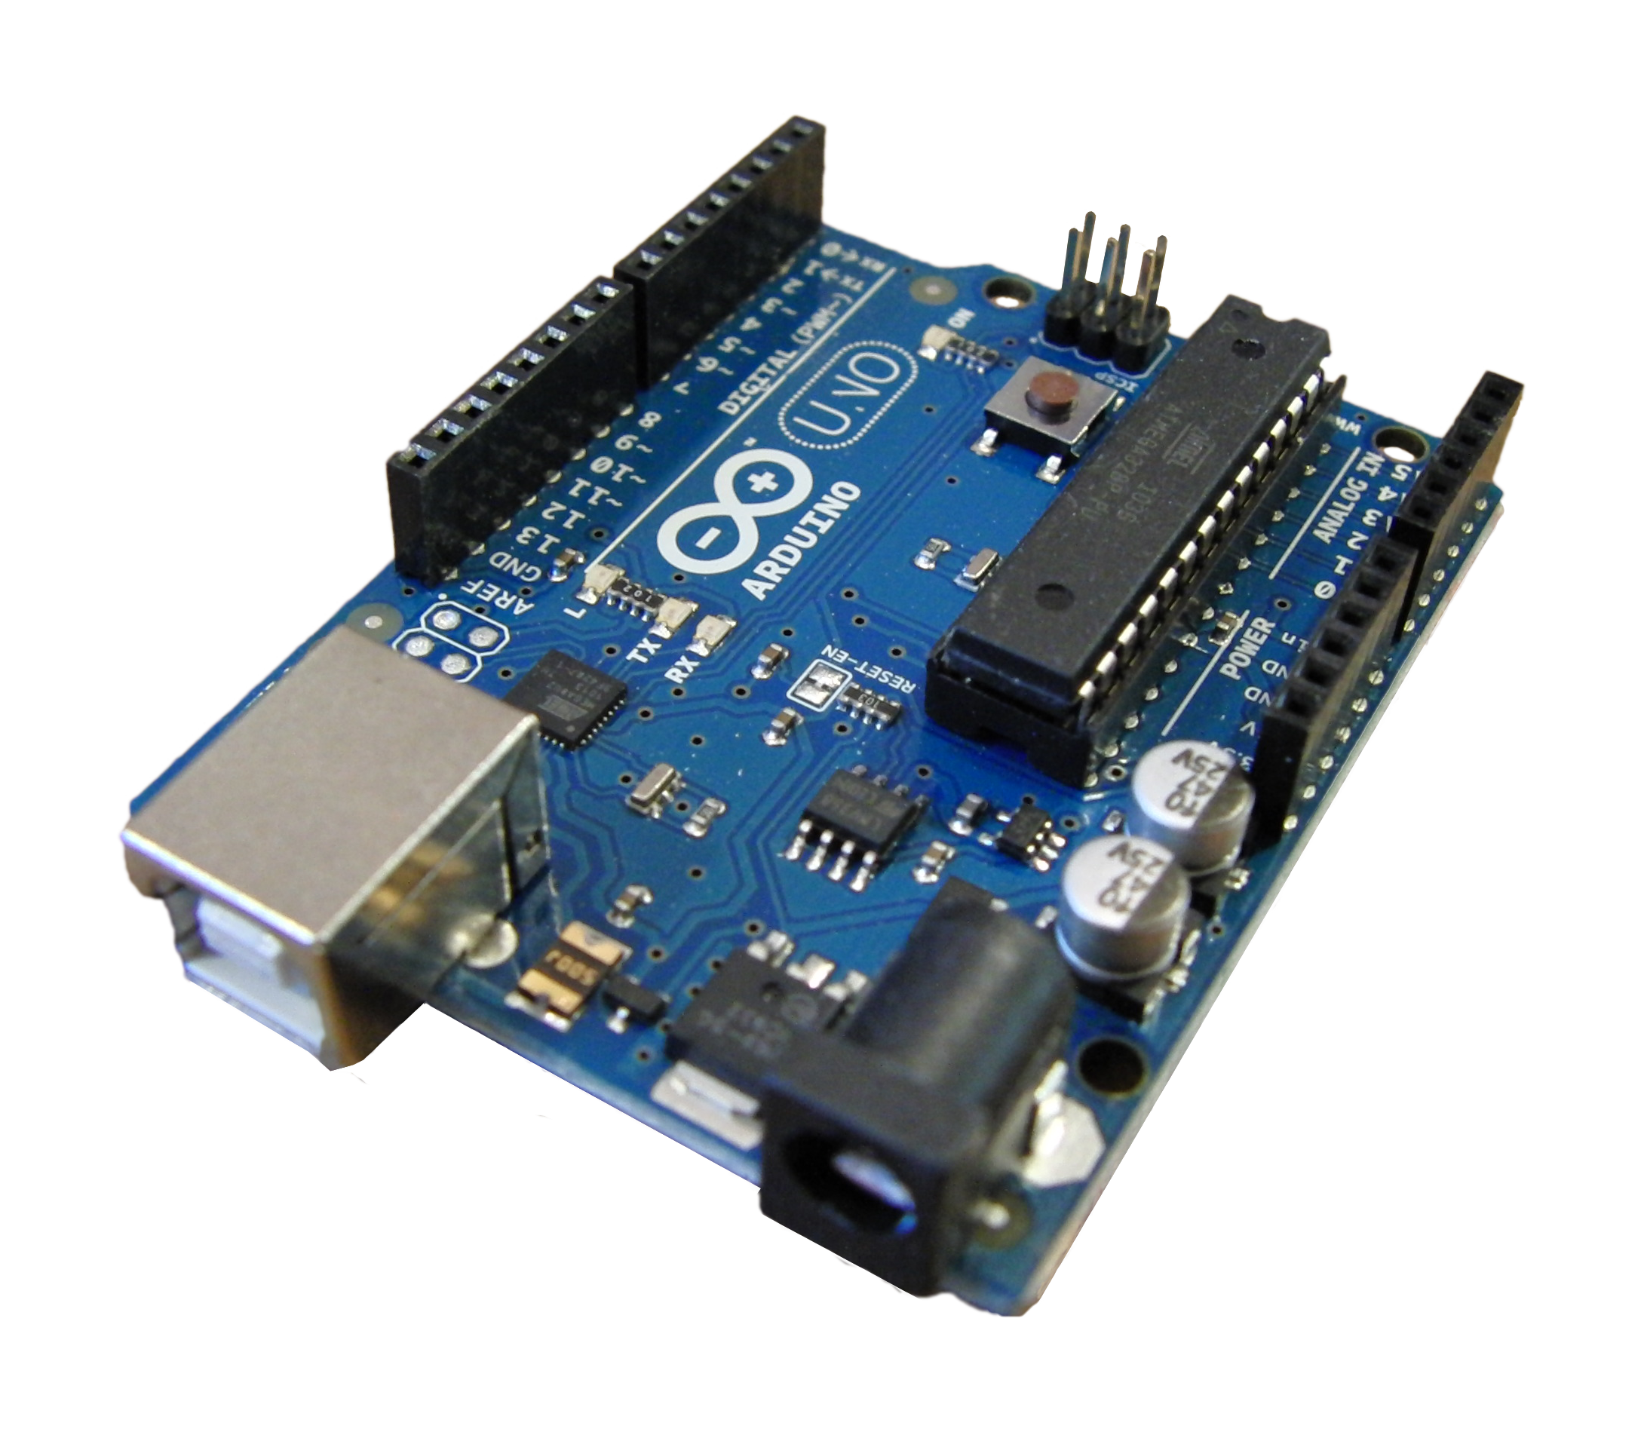
Arduino Workshop!
Presented by Melissa, WiCS and our lovely mentors!

Slide 2
Workshop Structure
Electricity and Circuits
Microcontrollers and Embedded Programming
Arduino!
Lunch
Projects

Slide 3
Basic Circuits
Voltage: potential difference / electromotive force.
Measured in Volts (V)
Current: rate of the flow of charges.
Measured in Amps (A)
Resistance: impedes the flow of charges.
Measured in Ohms (Ω)
Ohm's Law: V = IR
You'll be using this to calculate things needed for projects!

Slide 4
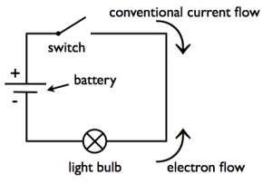
Basic Circuits
Closed and open circuits

Slide 5
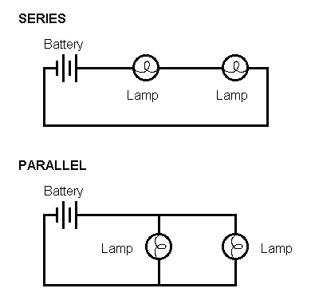
Basic Circuits
Series vs parallel circuits

Slide 6
Microcontrollers and Embedded Programming
Embedded programming: Programming a mini computer
Sensors: Devices that detect or measure things from the outside world
Actuators: Device that “moves” in the real world by sending commands to it from a computer
Microcontroller: Mini computer on a chip containing a processor core, memory and programmable I/O
Digital vs Analog: discrete vs continuous signal

Slide 7
Why Arduino?
Do not need to worry about analog sampling – Arduino does it for you!
Simple and clean programming language – based on C
Open-source!
Cross platform

Slide 8
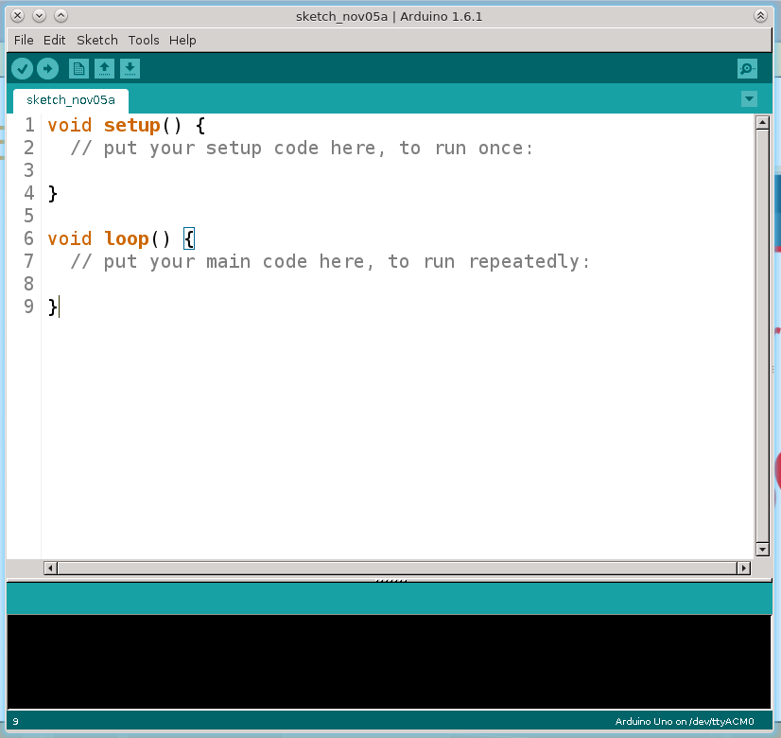
Arduino IDE
Toolbar
Tab Options
Console

Slide 9
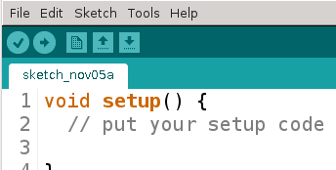
Arduino IDE
Save
Open
New
Upload
Compile

Slide 10
Arduino IDE
Before we can start programming:
Select the type of Arduino board we will be using:
Tools >> Board
Select “Arduino Uno”
Select the Serial Port the microcontroller is connected to:
Tools >> Serial Port
Select the serial port the Arduino is connected to
(if you don't know which, test and check)

Slide 11
Programming with Arduino
Mostly C-based structure
Comments:
// single line comments
/* multi-line
comments */
Variables:
Boolean: boolean variableName;
Integer: int variableName;
Character: char variableName;
String: char stringName[];

Slide 12
Programming with Arduino
void setup() {}
Method is run once, at the beginning
Used to (as the name imply) initialize things and set up
Initialize pins:
pinMode(pin#, TYPE)
TYPE = INPUT or OUTPUT
Initialize serial communication:
Serial.begin(baud_rate);

Slide 13
Programming with Arduino
void loop() {}
After setup() is run, loop() is run continuously until the program is terminated
Analogous to while(true) {}

Slide 14
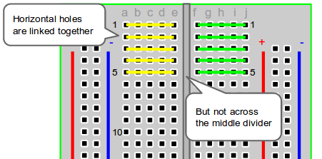
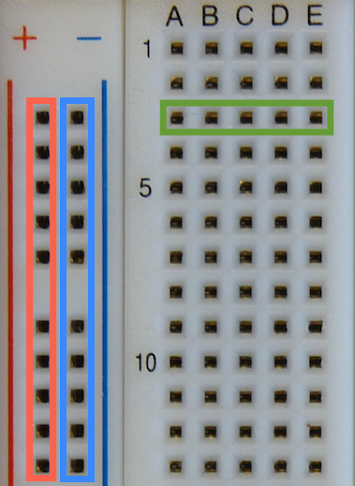
Prototyping Circuits - Breadboards
Power supply
Ground

Slide 15
Lunch!

Slide 16
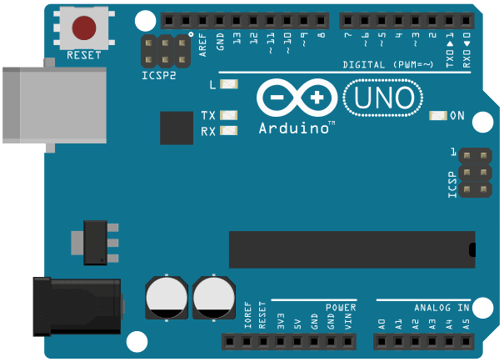
Arduino

Slide 17
Project 1: Blinking the “L” LED
Built-in Arduino LED is located at pin 13
LEDs are always initialized as output pins
Step 1: Initialize the LED pin
Step 2:
Turn on the LED
Wait for 1 second
Turn off the LED
Wait for 1 second
Repeat

Slide 18
Project 1: Blinking the “L” LED
digitalWrite(pin#, state)
pin#: integer, corresponding to one of the GPIO pins on the board
state: HIGH (on) or LOW (off)
The voltage level you are setting for the pin specified
delay(time)
time: time in milliseconds

Slide 19
Project 1: Blinking the “L” LED
To check that your code runs, press the “verify/compile” button
To get your code to actually run on the board, press the “upload” button

Slide 20
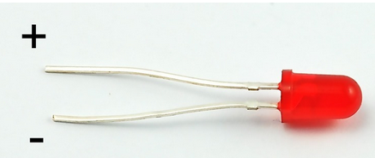
Project 2: Blinking the Red LED
Now we're going to add external hardware!
LEDs:
Long leg = + terminal
Short leg = - terminal
MUST be used with a resistor to limit the current running through them!

Slide 21
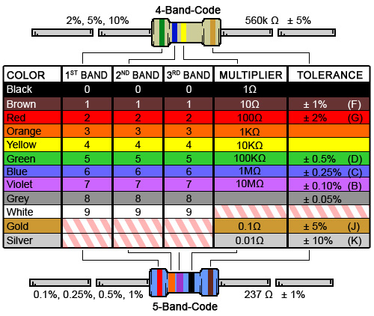
Project 2: Blinking the Red LED
Resistor (Ω)
No polarity
(can be connected
any way)
Value determined by
colour code (see right)

Slide 22
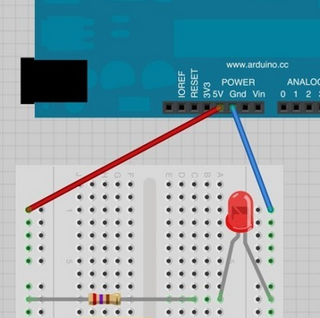
Project 2: Blinking the Red LED
Required components:
Red LED, two wires, 150Ω and 1.5kΩ resistors
Set up with the 150Ω resistor, then
1.5kΩ resistor. What's the
difference?
What happens if you put the resistor
on the other side of the LED?

Slide 23
Project 2: Blinking the Red LED
Switch the connector from 5V pin to pin 7
Step 1: Initialize the LED pin (for pin 7)
Step 2:
Turn on the LED
Wait for 1 second
Turn off the LED
Wait for 1 second
Repeat

Slide 24
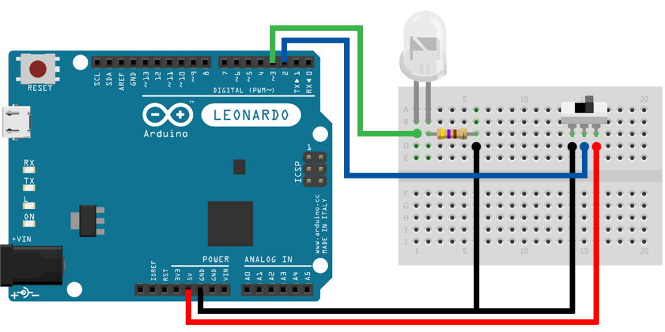
Project 3: Digital Inputs
Components: red LED, 4 wires, 150 Ω and slide switch
Hardware set-up:
Connect left leg of switch to GND, middle leg to pin 2, right leg to 5V
Connect the red LED and resistor in series (LED connected to pin 3)

Slide 25
Project 3: Digital Inputs
Software setup:
Initialize LED pin as an output
Initialize switch pin as an input

Slide 26
Project 3: Digital Inputs
To read the switch state:
state = digitalRead(pin#)
State will either be HIGH or LOW
Set the LED
digitalWrite(LEDpin#, state)
Will set itself HIGH or LOW, depending on the status of the switch

Slide 27
Project 4: Photocell – Light Sensor
Components: LDR, 3 1.5kΩ, 100Ω, green LED, 7 wires
What is a LDR?
Light Dependent Resistor (LDR or photocell)
Initially it has a very high resistance, but as light hits the surface, the resistance drops allowing more current to go through

Slide 28
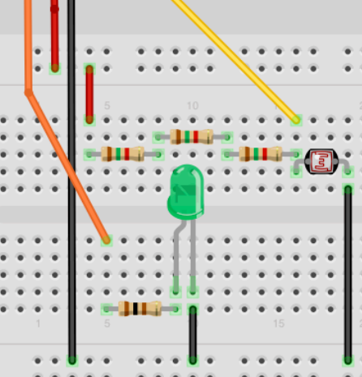
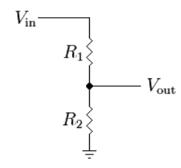
Project 4: Photocell – Light Sensor
Hardware setup:
Red = 5V
Orange = Pin 6
Yellow = A0 //analog pin 0
Black = Ground (GND)
R1 = 4.5kΩ
R2 = LDR
Vin = ?
Vout = ?

Slide 29
Project 4: Photocell – Light Sensor
Step 1: Setup
Initialize the LED pin
Step 2: Loop
Read the analog value from photocell
analogRead(pin#)
Turn LED on
Wait for time indicated by analogRead(pin#)
Turn off LED
Wait for time indicated by analogRead(pin#)

Slide 30
Project 4: Photocell – Serial Communication
Lets you send text from the Arduino to your computer (useful for debugging!)
The Arduino must be connected to the computer by USB for this to work
Let's try it out:
In setup:
Serial.begin(9600);
while(!Serial) {}
In loop:
Serial.println(photocell)
photocell is the value given to you by analogRead
Make sure that Serial.available() == true
After uploading the program, click on the serial monitor button to read

Slide 31
Project 5: Traffic Light
Specs:
Turn on red light
Wait 5 seconds
Turn on yellow light
Wait 3 seconds
Turn on green light, turn off red and yellow light
Wait 5 seconds
Turn on yellow light, and turn off green light
Wait 3 seconds
Turn off yellow light

Slide 32
Project 6: Interactive Traffic Light
Specs:
Same as Project 5 (Traffic Light), but two sets of lights – one for cars, one for pedestrians (pedestrians only have green and red, flashing green is used for yellow)
The car lights stay green (and the pedestrian lights red) unless a pedestrian is present (indicated by switch toggled on), in which case you alternate between the car lights and the pedestrian lights being green

Slide 33
Project 6: Interactive Traffic Light
Initially: carGreen on, pedRed off
If button is pressed, change lights after 5 seconds
carGreen off, carYellow on
Wait 3 seconds
carYellow off, carRed on
Wait 1 second
pedRed off, pedGreen on
Wait for 5 seconds or more
Flash pedGreen 10 times
pedGreen off, pedRed on
Wait 1 second
carYellow on, carRed off
Wait 1 second
carGreen on, carYellow off

Slide 34
Hardware Purchasing Resources
Newark
Digikey
Adafruit *
Sparkfun *
* beginner friendly, has tutorials on their website!

Slide 35
Arduino Function Reference
digitalWrite(pin#, STATE)
digitalRead(pin#)
Returns STATE (HIGH or LOW)
analogRead(pin#)
Returns integer between 0 and 1023
delay(time)
Time is in milliseconds

